Slide 1
OrangeHRM
Site: https://opensource-demo.orangehrmlive.com/web/index.php/auth/login
By
Saravanan Ramu

Slide 2
OrangeHRM
Orange HRM is Human Resource Management Site. With each section they have many funtions that help any HR team.
OrangeHRM serves any company size and unique business case. With the options of customization or out of the box, you can make OrangeHRM work the way you need it to.

Slide 3
Scenarios
Login With valid and Invalid login Scenarios.
Recruitment Tab -Add,Verify,Search,View and Delete Candidate.
Recruitment Tab - Add,Verify,Search,Edit and Delete Vacancy
Performance Tab - Add,Edit,Search and Delete Manage Reviews.
Performance Tab- Search and view Employee Trackers
Copyright 2023 © ATMECS Global Inc. | CONFIDENTIAL

Slide 4
Project Specifications
Language : Java(1.8)
Tool : Selenium(4.8.0)
IDE : Eclipse(4.26.0)
Testing Framework : TestNG(7.4.0)
Build Management Tool : Maven(3.8.6)
Log Management Tool : Log4j(2.0.6)
Test Data : Excel(5.2.2)
Version Control : GitLab
Copyright 2023 © ATMECS Global Inc. | CONFIDENTIAL

Slide 5
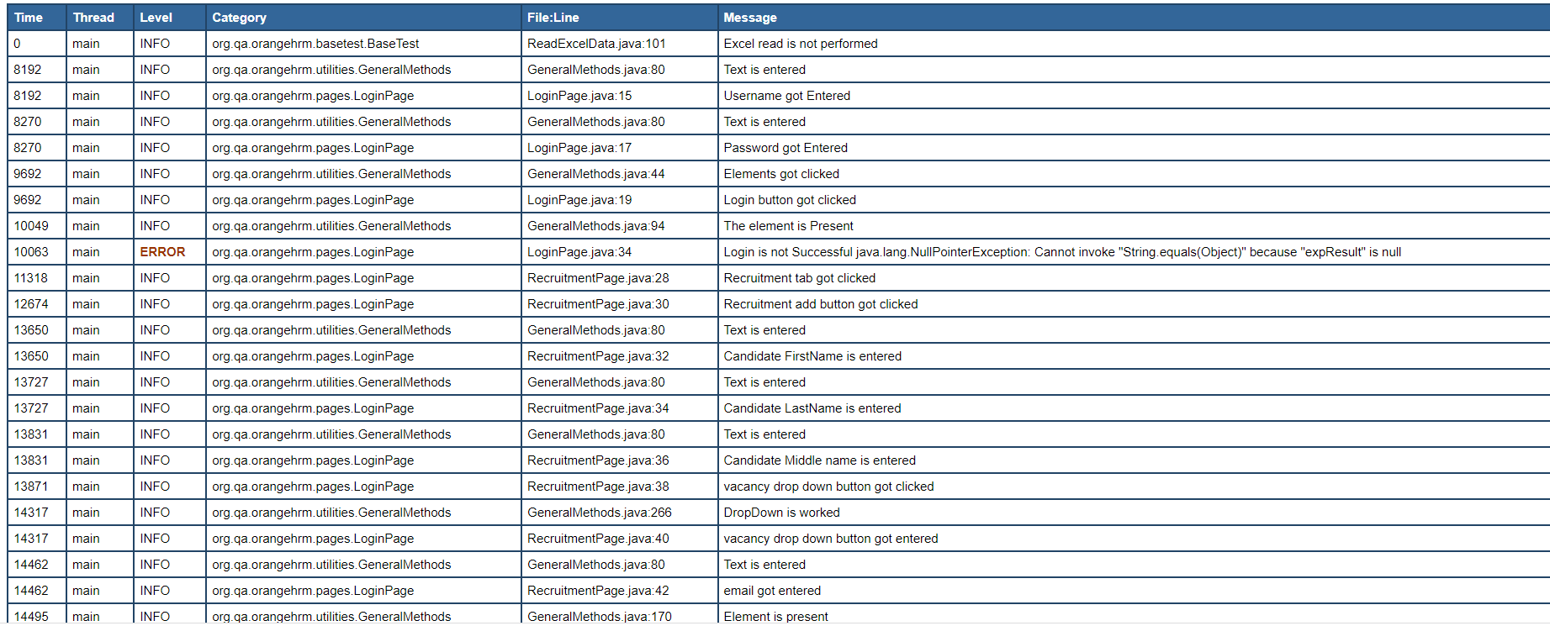
Report:

Slide 6
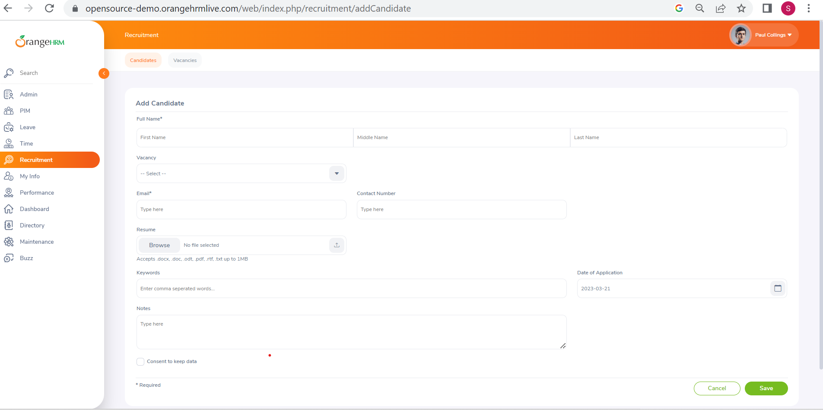
Demo

Slide 7
Thank you
Copyright 2023 © ATMECS Global Inc. | CONFIDENTIAL

